Slide 1
Project weekly deliverable
Sarah Christie

Slide 2
Week 1
Topic - Pokemon type distribution
A thing I noticed a lot in my 11 years of playing pokemon, was that in spit of there being only a select few types in the games, some individual typings, or type combinations were constantly seen and complained about. Types such as Grass, Fire/Fighting, or Ghost/Poison, to name a few I heard from friends. So I wanted to check. Through currently 9 generations and roughly 1025 pokemon, what types are the most common amongst them, and what traits do they show?

Slide 3
Data Profile - Pt 1 (This has 1032* rows and 16 columns)
Column Name | Has data missing? | Data Type - Numeric or Free type | Useful? | Need cleaning/processing?
id | Yes | Numeric | Yes | Yes
pokemon | Yes | Free type | Yes | Yes
species_id | Yes | Numeric | Yes | Yes
height | Yes | Numeric | Yes(?) | Yes
weight | Yes | Numeric | Yes(?) | Yes
base_experience | Yes | Numeric | No | No
type_1 | Yes | Free type | Yes | Yes
type_2 | Yes | Free type | Yes | Yes
hp | Yes | Numeric | No(?) | Yes
Notes:
*row amount set to change

Slide 4
Data Profile - Pt 2
Column Name | Has data missing? | Data Type - Numeric or Free type | Useful? | Need cleaning/processing?
attack | Yes | Numeric | No(?) | Yes
defense | Yes | Numeric | No(?) | Yes
special_attack | Yes | Numeric | No(?) | Yes
special_defense | Yes | Numeric | No(?) | Yes
speed | Yes | Numeric | No(?) | Yes
color_1 | Yes | Free type | No | No
color_2 | Yes | Free type | No | No
color_f | Yes | Free type | No | No
egg_group_1 | Yes | Free type | Yes | Yes

Slide 5
Data Profile - Pt 3
Column Name | Has missing data? | Data Type - Numeric or Free type | Useful? | Need cleaning/processing?
egg_group_2 | Yes | Free type | Yes | Yes
url_icon | Yes | Numeric | No | No
generation_id | Yes | Free type | Yes | Yes
url_image | Yes | Free type | No | No

Slide 6
Questions
What individual type has th most pokemon?
Which type combination has the most pokemon?
In each generation, what is the type distribution?
Which generation of pokemon has the most of each type?
Is there any relationship between type variety and gameplay?

Slide 7
Who and why?
This will mostly a self indulgent data analysis, as I feel like this is a very specific and frankly silly question and data analysis. Also, this will be for my friends who tried to tell me that grass is an overrated type with too many of “virtually the same pokemon”. And I need to prove them wrong. Finally, this will be for anyone else asking this seemingly innocuous question, and to stop them in advance from making an 1000+ row data spreadsheet to answer “Is Fire/Fighting the most common starter final evolution type combination?” (Which, the answer is yes.).

Slide 8
Week 2 progress
Most of my progress this week has been updating the data sheet! And I am still not done! Help!
As mentioned in the diary, I found out that I may need to go over to 950 already submitted pokemon to check for discrepancies from roughly 8 to 10 years ago.
I am currently using the most recent games (Pokemon Scarlet and Violet, Pokemon Legends Z-A) for checking pokemon data, as well as a pokemon data site named bulbapedia, a fan hosted site similar to wikipedia that has access to any pokemon’s information I cannot obtain from th two mainlin games, whether from my lack of owning the game, or the pokemon not appearing in th latest generation at all.

Slide 9
Week 3
Hey. I’m gonna be fully transparent. I was not able to do anything this week.

Slide 10
Week 4- hhhhhhhhhh (Data is done!)
Most of week 4 was focused on finishing up my data sheet. I accepted that th amount I could finish within a reasonable amount of time. So the current data sheet is up to Generation 8. Along with that, I can now generate data plots!

Slide 11
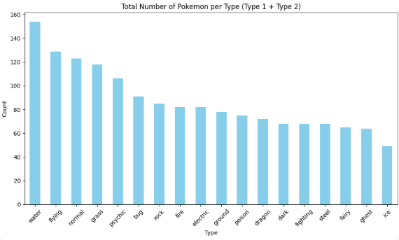
Data Analysis
This chart shows th total amount of pokemon per type, including primary types and secondary types (if applicable)
Top 3 most common types are water (suprising!), flying, and normal types
Top 3 least common are ice, ghost, and fairy
Fairy has only been in 2 generations and yet has more than ice and ghost

Slide 12
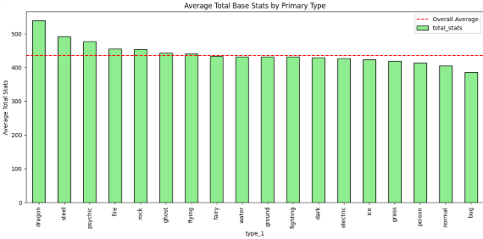
Data Analysis
This Table takes the average total base stats of each pokemon’s primary type and lists them from highest to lowest.
Dragon types have the highest base stats
Bug types have the lowest
Of the “core 3 types” (fire, water, grass) Fire has the most base stat average and grass has the least

Slide 13
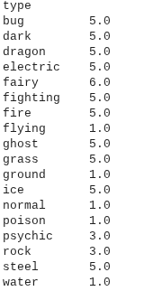
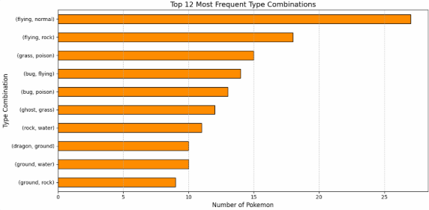
Data Anaylsis
Table on the left is most pokemon introduced per type
Most are generation 5, which introduced the most pokemon
Graph on the right is the top most frqunt type combinations
Most frequent type combo by a long shot is normal flying

